Slide 1

GitHub Actions: From Zero To Hero
Slides up at scottsauber.com
scottsauber

Slide 2

What you need
Git
GitHub account
An Editor (VS Code, Visual Studio, JetBrains IDE, etc)
Search for a GitHub Actions extension in your editor of choice
Fork this repo https://github.com/scottsauber/github-actions-workshop
Optional: .NET 9 (if you want to run the app locally, but not needed)
scottsauber

Slide 3
What we all need
GitHub to not go down
GitHub Actions to not go down
The conference internet to not go down
🙏🙏🙏
(I do have recordings but that’s less fun)
scottsauber

Slide 4
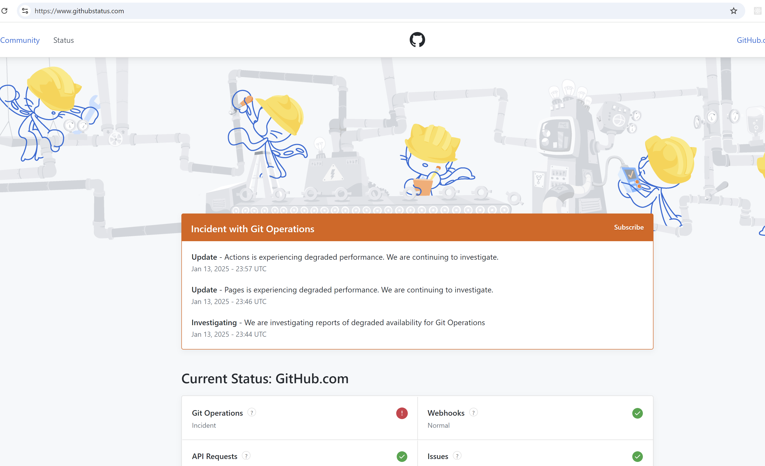
A few months ago ~4 hours before this workshop…
scottsauber

Slide 5
Audience
Anyone interested in GitHub
People interested in DevOps but rarely/never get to do it
Already know Git
If you have questions, ask! Otherwise this is gonna be a boring 4 hrs
scottsauber

Slide 6
Poll
How many people using GitHub already?
How many are using GitHub Actions?
How many feel like they’re pretty intermediate to advanced wit GHA?
What other CI/CD tools are people using?
Why are you here? What do you want to learn?
scottsauber

Slide 7
Agenda
What is CI and the two CDs?
What are GitHub Actions?
GitHub Actions concepts
Configuring Optimal GitHub settings
Creating PR Verify workflow
Creating CI workflow
Cron Jobs
Variables and Secrets
Reusing workflows
Things every CI/CD workflow should have
scottsauber

Slide 8
Goals
Understand what GitHub Actions are
Get experience using GitHub Actions
Few takeaways for experienced GitHub Actions users
scottsauber

Slide 9




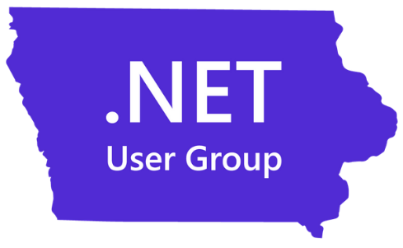
Who am I?
Director of Engineering at Lean TECHniques
Microsoft MVP
Dometrain Author
Redgate Community Ambassador
Co-organizer of Iowa .NET User Group

Slide 10
CI/CD Pipelines

Slide 11
What is Continuous Integration?
Automated verification of your application
Generates artifacts
Compiles the app
Runs the tests
Independent witness – eliminates “works on my machine”
scottsauber

Slide 12
What is Continuous Delivery?
Takes artifacts from CI and deploys them automatically
Doesn’t deploy all the way to Production
Deploying to Production is a button click
scottsauber

Slide 13
What is Continuous Deployment?
Deploys all the way to Production automatically
If the pipeline is green, it’s going to Production
scottsauber

Slide 14
Why CI/CD?
Avoid manual steps (chances for mistakes)
Repeatable
Auditable
Humans need less permissions
scottsauber

Slide 15
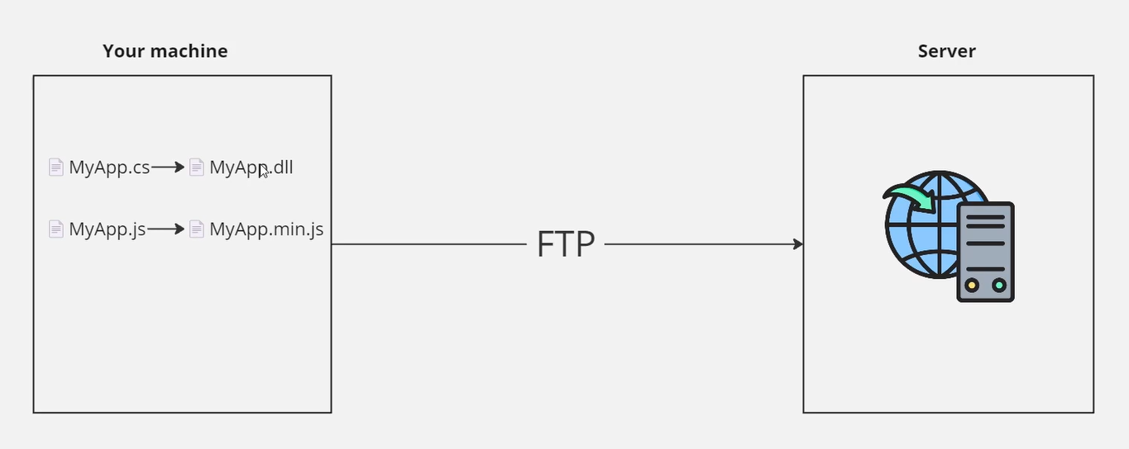
Before CI/CD
scottsauber

Slide 16
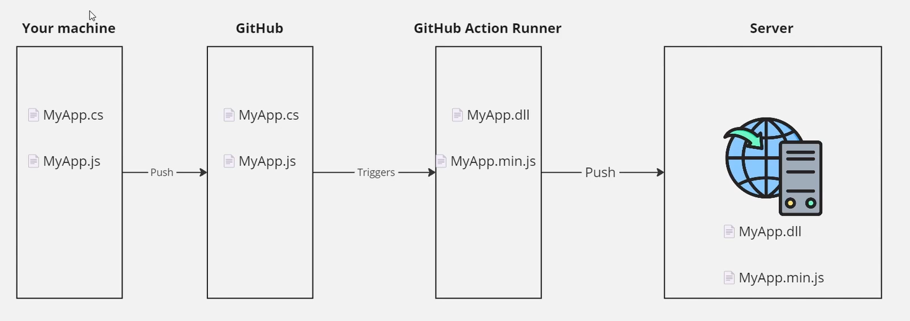
After CI/CD
scottsauber

Slide 17
Confident Green
If our build passes – why aren’t we shipping to Production?
Likely lack of confidence or automation
Likely missing automated tests or zero downtime deployments
Let’s fix that
Ok now why?
Repeat
scottsauber

Slide 18
Ideal CI Pipeline?
Restore Packages
Compile
Test
Format
Linting
Security Scans
Upload Artifacts
Alerting on Failure
scottsauber

Slide 19
Ideal CD Pipeline?
Download Artifacts
Deploy Artifacts (IAC, DB changes, Application)
Zero Downtime Deployments
Smoke Tests
Security Scans
Alerting on Failure
scottsauber

Slide 20
CD Today?
Not going to cover CD today
Complexity with deploying to Azure
Workshop link for a workshop I’ve done on “Deploying a .NET 9 app to Azure using GitHub Actions and Bicep” - https://github.com/scottsauber/workshop-dotnet-azure-github-bicep
This is an all day workshop
Also you can buy my Dometrain course – my kids’ basketball traveling teams thank you
scottsauber

Slide 21
Questions about CI/CD?

Slide 22
GitHub Actions

Slide 23
What is GitHub?
Most popular place for storing source code
Both public and private
80% of our clients are on GitHub, ~20% on Azure DevOps
Some moved from BitBucket in last 2-3 years
scottsauber

Slide 24
What are GitHub Actions?
Built into GitHub
Thing Doer on a trigger
Trigger could be PR, push to a branch, open an issue, cron, etc
Usually used to automatically build and deploys your application
~70% of our clients are using GitHub Actions
Most of these have moved in last 2-3 years (Aug 2018 GHA came out)
scottsauber

Slide 25
GitHub Actions Concepts
Steps – individual actions to be executed (ie restore packages, compile, etc)
Jobs – a series of Steps
Workflows – a series of Jobs
Triggers – something that kicks off the workflow
Inputs – parameters to customize a job
Secrets – sensitive data store in GitHub, can be leveraged in a Workflow
Runners – Virtual Machines that run Jobs, could be GH-hosted or self-hosted
scottsauber

Slide 26
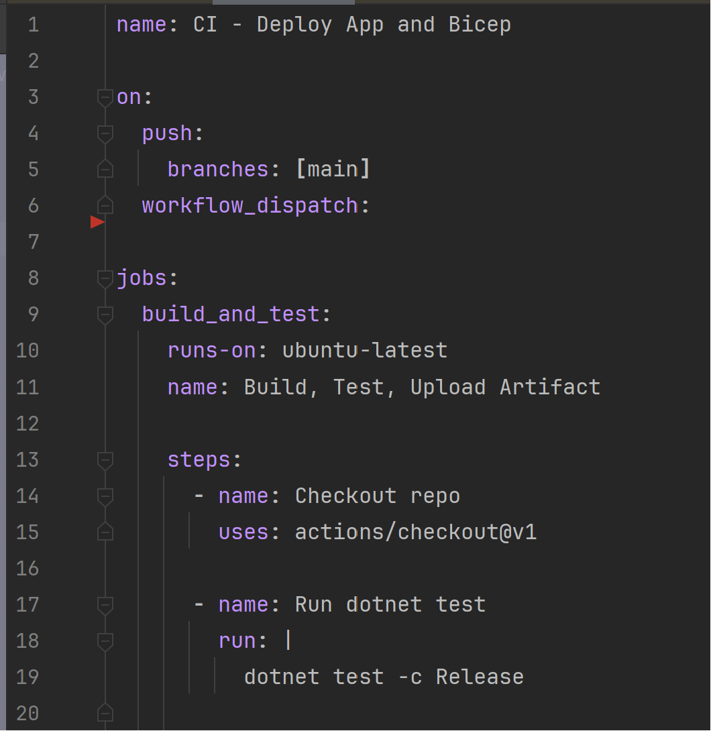
Example
scottsauber

Slide 27
Questions about GitHub Actions?

Slide 28
Live Demo
Notes:
Show Marketplace
Install GitHub Actions extension

Slide 29
10 minute break Then Module 3

Slide 30
Questions about Module 3?

Slide 31
Optimal* GitHub Settings * synonym for “my opinions”

Slide 32
Optimal GitHub settings
Repo => Settings
Pick 1 merge strategy – I use Squash bc most people suck at making a good history
✅Always suggest updating pull request branches
✅Allow auto-merge
✅Automatically delete head branches (GitHub flow or TBD)
✅Configure required status checks as Ruleset (note: merge first)
scottsauber

Slide 33
Live Demo

Slide 34
Questions about Optimal GitHub Settings?

Slide 35
Module 5: Let’s merge the PR and set up a required rule set

Slide 36
Questions about Required Rule Sets?

Slide 37
Module 6: CI Workflow On Your Own

Slide 38
Module 6: Review

Slide 39
5 Minute Break?

Slide 40
Reusable Workflows

Slide 41
Reusing Workflows
Copying Pasting YAML feels kinda bad
GitHub Actions allows reusing workflows via `workflow_call` trigger
scottsauber

Slide 42
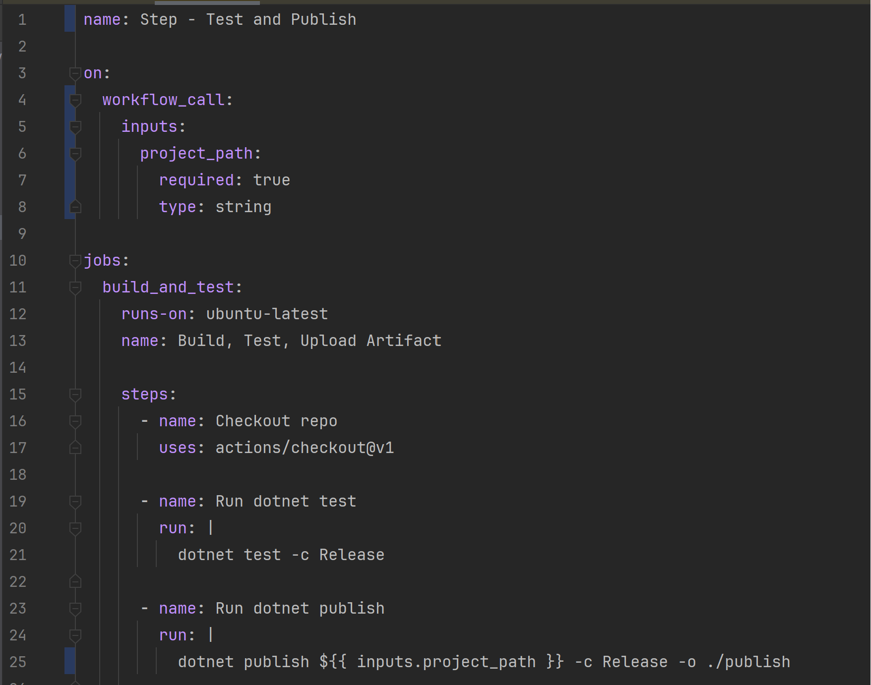
How do I reuse workflows?
scottsauber

Slide 43
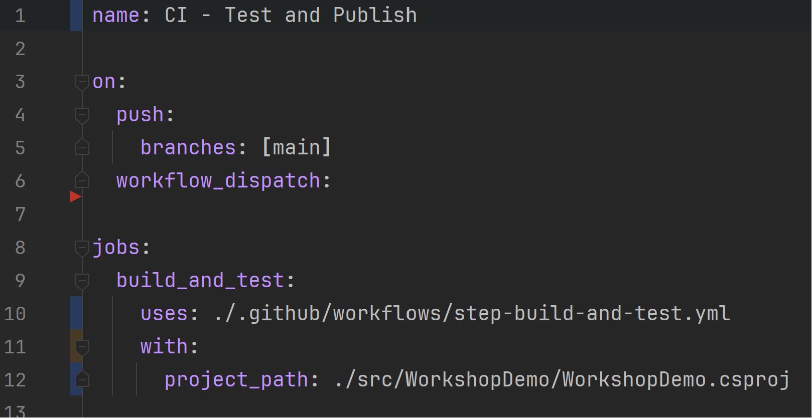
Consume reusable workflow
scottsauber

Slide 44
Module 8: Reusable Workflows

Slide 45
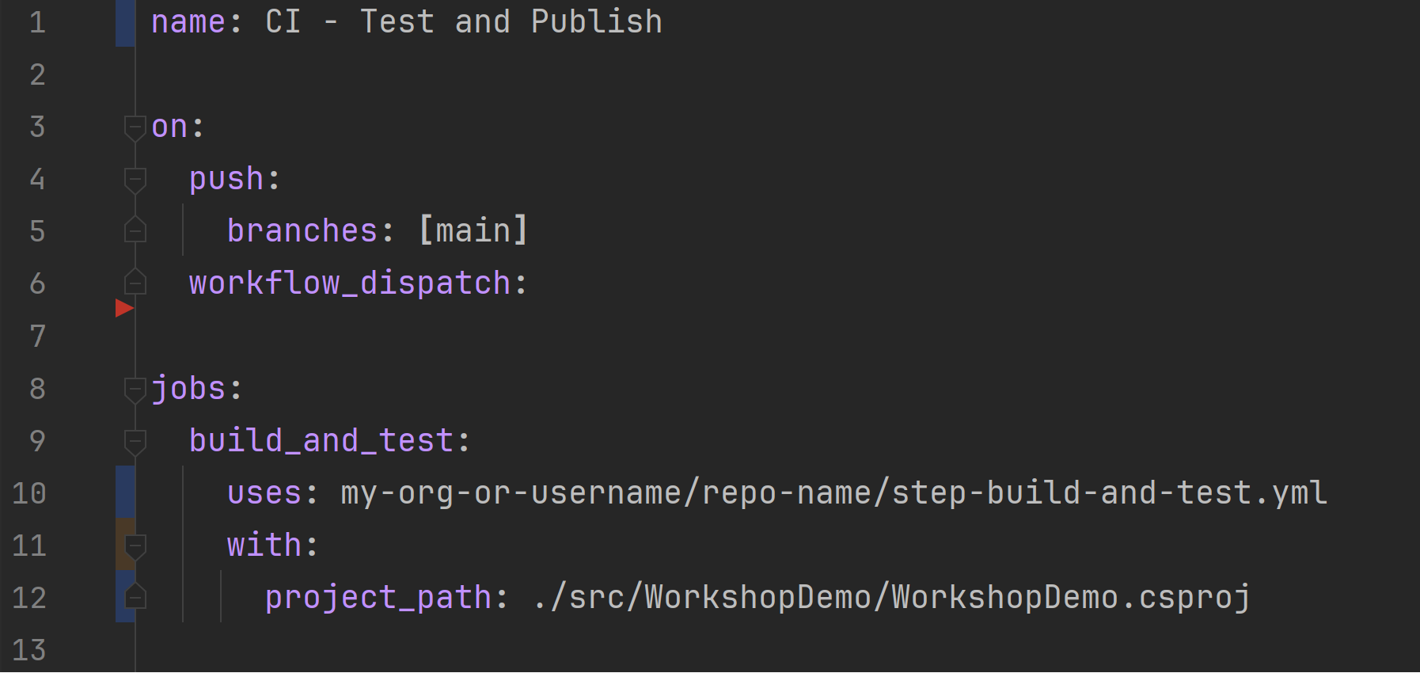
Consume reusable workflow from another repo
scottsauber

Slide 46
Module 10: Reusable Workflows in another repository

Slide 47
Questions about reusable workflows?

Slide 48
Module 10: Reusable Workflows in another repository

Slide 49
Secrets

Slide 50
Secrets
Similar to Inputs, allows you to pass in dynamic values
Secrets are wildcarded out of the build logs
They are write only, not read
Note: you could still exfiltrate secrets via API calls, text files, etc
Could be Client IDs and Secrets, API Keys, Connection Strings, etc
scottsauber

Slide 51
Module 12: Secrets

Slide 52
Questions about Secrets?

Slide 53
Variables

Slide 54
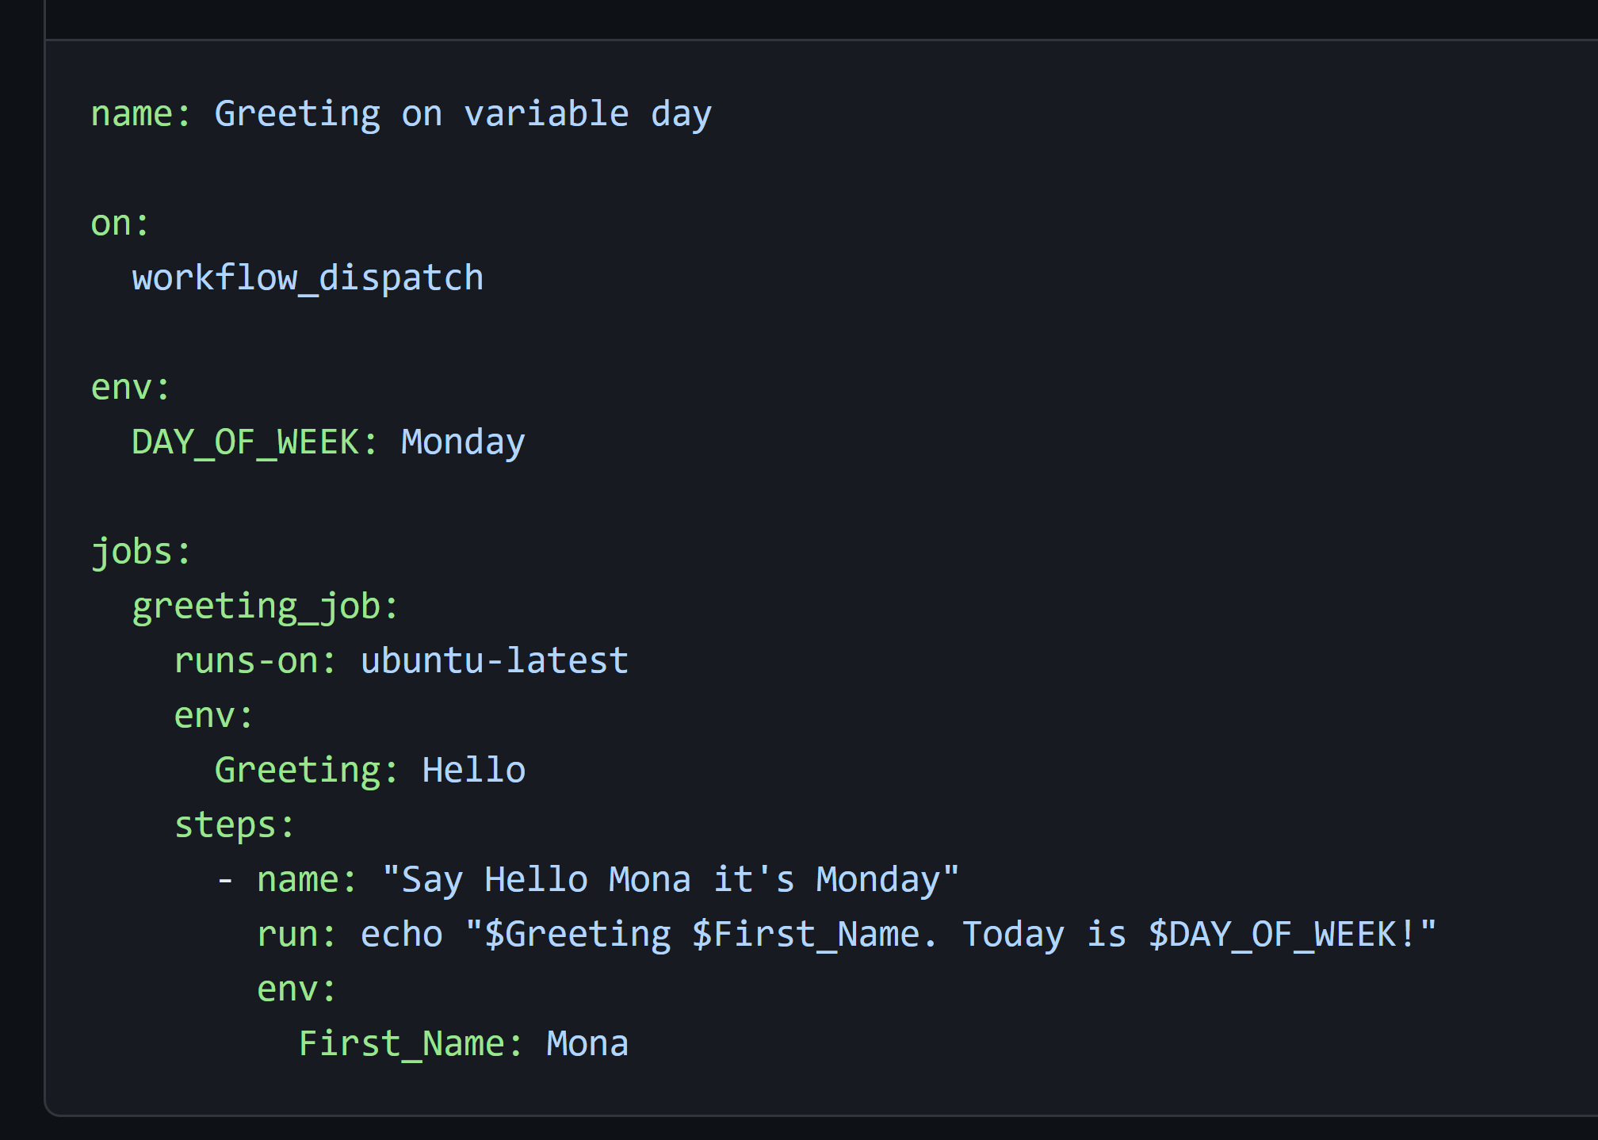
Variables
For use inside the same workflow file
Store common paths, versions, or any common string used throughout the workflow
scottsauber

Slide 55
Questions about Variables?

Slide 56
Random GHA Tips

Slide 57
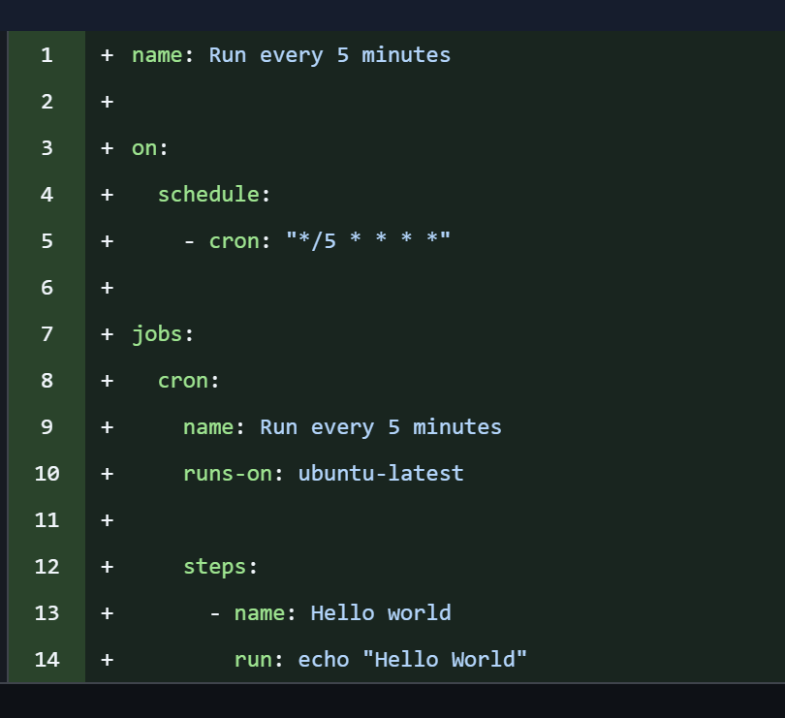
Cron Jobs
Not meant to be an enterprise scheduler
No guarantees it runs the time you tell it to
I’ve seen it run consistently, but up to 15 minutes later
scottsauber

Slide 58
Cron Jobs
Useful for running security scans for repos that don’t get touched very often
But also run security scans on each change
Don’t use this to run a daily build, run a build on every commit
scottsauber

Slide 59
Environments
Allow you to define the environments for deploying your application
Useful to see what’s deployed successfully
Allows you to set “Required Approvers” for things like the Production environment
Allows you to use environment secrets
scottsauber

Slide 60
Live Demo of Environments

Slide 61
GitHub Actions Hero
https://github-actions-hero.vercel.app/
scottsauber

Slide 62
Pinning Dependencies
Using ubuntu-latest will break your app
Instead – pin to things like ubuntu-22.04
Likewise can pin dependencies
- uses: actions/checkout@v4.2.2 …. becomes - uses: actions/checkout@11bd71901bbe5b1630ceea73d27597364c9af683
Prevents a malicious actor who gains control of repo (supply chain attack) and changes what 4.2.2 means
But also promotes consistent builds
But comes at cost of no free upgrades with a @v4
scottsauber

Slide 63
Breaking Changes
The downside of not being on the latest – you might not have the latest security fixes
https://github.com/actions/upload-artifact/issues/602
scottsauber

Slide 64
Bonus: Git Aliases
https://github.com/scottsauber/dotfiles/blob/main/.bashrc
gnewbr
gcpr
gas
gcp
pr
gpo
gcopm
scottsauber

Slide 65
More Random tips
Leverage ChatGPT/Copilot/Cursor/Claude Code – they’re really good at YAML
path filters
Sparse checkouts
scottsauber

Slide 66
More Random tips
When deploying to the cloud – use Federated Credentials (Azure) or Federated Identity (AWS)
Passwordless
Allows you to authenticate and say “this org and repo can deploy to this account”
This is something we check on our Azure Cloud Health Check and 90% of companies aren’t doing this
scottsauber

Slide 67
Resources
This slide deck
https://github.com/scottsauber/github-actions-workshop
https://github.com/scottsauber/workshop-dotnet-azure-github-bicep
scottsauber

Slide 68

Questions? ssauber@leantechniques.com @scottsauber.com on Bluesky @scottsauber on Twitter
Schedule time with me:
Slides at scottsauber.com
scottsauber

Slide 69
Thanks!
Slides up at scottsauber.com
scottsauber

